Slide 1

Context-Setting
BEST START REGIONAL NETWORKS LEARNING DIALOGUE
PRESENTERS:
Date:
10/18/2023
Jennifer Zhang

Slide 2

The housing crises in Los Angeles negatively impacts families with children

Slide 3
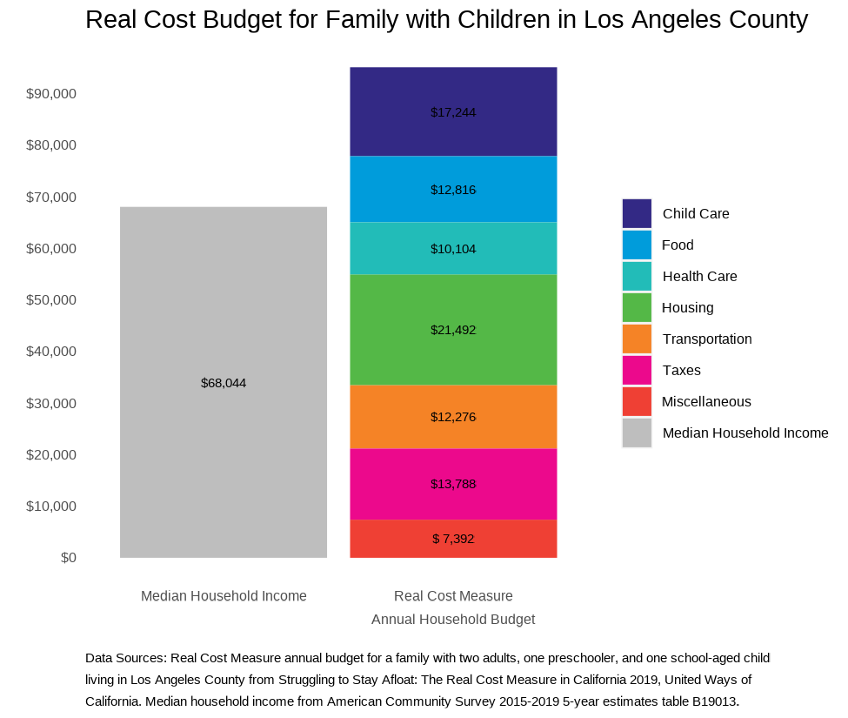
Real cost measure
There are several costs that are required to raise young children. With housing costs continuing to rise, there are less resources available for other essential needs.
Notes:
Can add the literature review content about accessing capital / wealth access. Also data on how BIPOC folks are disproportionately renters vs homeowners.

Slide 4
Housing instability & outcomes
For low-income households, high housing costs affect spending on other essentials and make their finances more vulnerable. High housing costs in California also contribute to poverty in the region. California also has one of the lowest homeownership rates in the country and households that do purchase a home take on more mortgage debt than other areas in the country. This affects the ability of households to build wealth.
Source: Legislative Analyst Office. March 2015. California’s High Housing Costs Causes and Consequences. Available here.

Slide 5
Housing instability & outcomes
Housing insecurity causes toxic stress that affects child development and later health outcomes and is linked to preterm birth for pregnant women which affects infant mortality and child health outcomes.
Housing instability is also associated with an increased risk for child neglect through higher reported maternal stress. Toxic stress increases the risk for life-long developmental problems in learning and behavior.
Source: Children’s Environmental Health Promotion Program & the Maternal, Child, & Adolescent Health Section. February 2019. San Francisco Department of Public Health brief: Health impacts of family housing insecurity. Available here.

Slide 6
Nearly a quarter-million LA county households fall into this low-wage, high housing cost trap

Slide 7
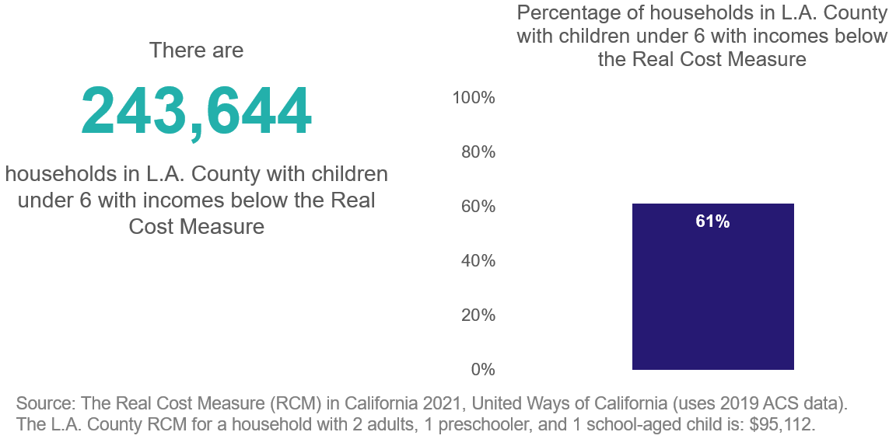
Magnitude of the problem
Over-time, there’s been a ~100,000 decrease in households with children 0-5 in LA County because of rising costs of living.
Source: “What’s Behind California’s Recent Population Decline.” Public Policy Institute of California. Available here

Slide 8
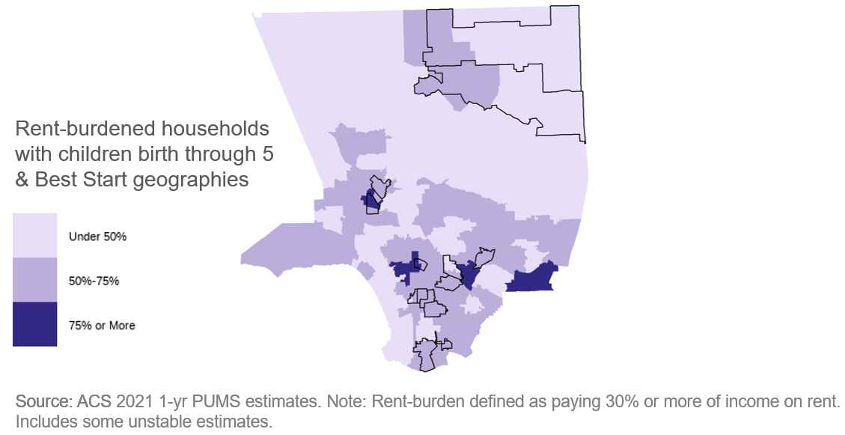
Magnitude of the problem
59% of LA County households with children 0-5 are rent-burdened, and many of these households are in Best Start Geographies.

Slide 9
Housing instability and rent burden varies by race

Slide 10
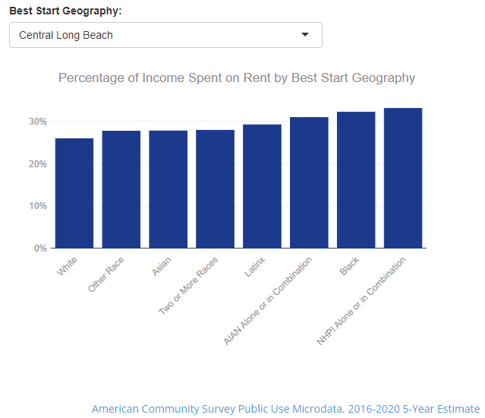
Disparities in housing insecurity
Across all Best Start Geographies, BIPOC households disproportionately spend a higher percentage of income on rent relative to White households.

Slide 11
Disparities in housing insecurity
Women in California are more likely to be rent-burdened and women-headed households and single mothers are more likely to be rent-burdened than their married or male counterparts. For example, 73% of single mothers are rent-burdened compared to 56% of single fathers. Black women are the most likely to be rent-burdened
Source: “Gender & Housing in California: An Analysis of the Gender Impacts of California’s Housing Affordability Crisis,” Gender Equity Policy Institute, August 2022. Available here.
Renters of color are also more likely to be cost-burdened than their White counterparts and Black renter households experience the highest rates of cost-burden.
Source: California Housing Partnership. June 2022. 2022 Los Angeles County annual affordable housing outcomes report. Available here.

Slide 12
Quality of housing & evictions are also important issues impacting families

Slide 13
Housing quality and outcomes
Higher housing costs contribute to overcrowding, which is shown to affect educational outcomes and well-being, and have weaker relationships with their children. Adults who live in overcrowded households are more stressed and socially isolated
Children in overcrowded housing have lower math and reading scores and have their sleep, mood, and behavior affected.
Households with children are more likely to live in overcrowded housing than other Californians and as hosing costs increase in a metro, so do overcrowding rates.
Source: Legislative Analyst Office. March 2015. California’s High Housing Costs Causes and Consequences. Available here.

Slide 14
Housing quality and outcomes
Infants and toddlers are particularly vulnerable to poor housing quality, such as household dangers like lead, asbestos, and mold. About 18% of households below the poverty line do not have air conditioning, which can contribute to higher risks of heat stroke and other health risks.
Source: Scheider, A., & Gibbs, H. December 2022. Disparities in housing, health care, childcare, and economic security affect babies for life. Center for American Progress. Available here.

Slide 15
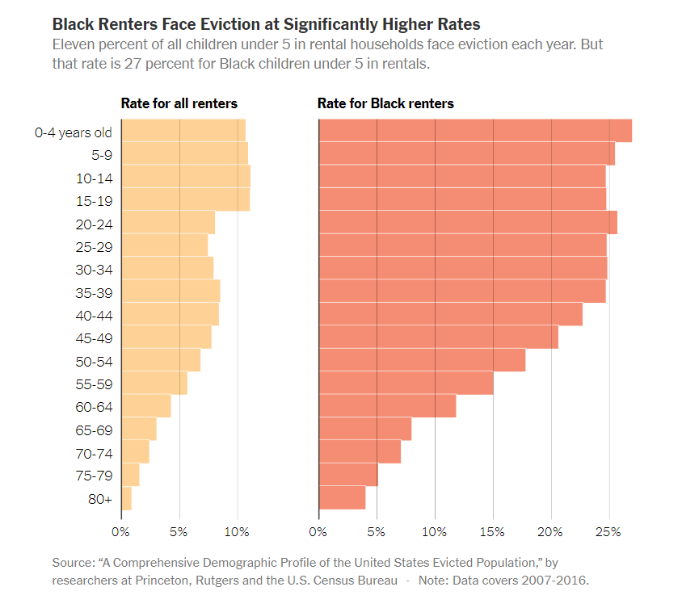
Evictions are disparate
Children 0-5 make up the largest age group among households that have had an eviction filed against them.
In a given year, about a quarter of Black children under 5 in rental homes live in a household facing an eviction filing.
Landlords consider young children an unwanted risk. For parents, having a baby comes with high financial costs, making them more likely to miss rent. Low-wage workers are also least likely to receive paid parental leave.
Source: “The Americans Most Threatened by Eviction: Young Children.” The New York Times. Available at: link

Slide 16
Zoning laws create racial segregation in where families own homes

Slide 17
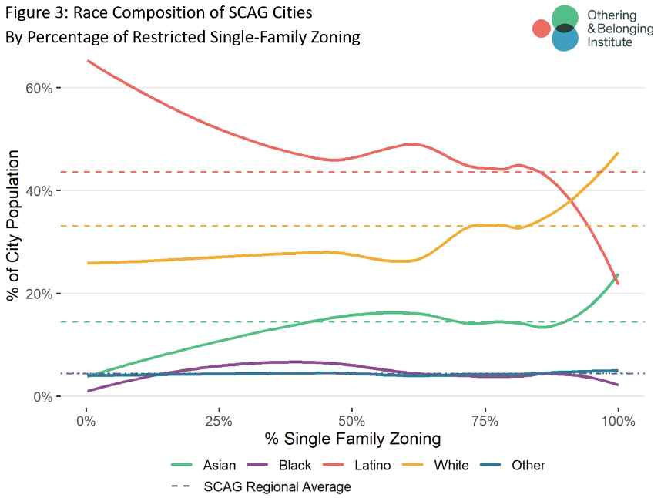
Single family zoning disparities and outcomes
"anti-density zoning appears to play a sharply exclusionary function, used by municipal jurisdictions to exclude lower-income people and people of color, or at least has that effect, in the greater LA region. It is not simply that these exclusionary communities use land-use regulation to maintain their exclusivity, they are denying access to vitalizing resources by hoarding those resources for themselves.“
Source: “Single-Family Zoning in Greater Los Angeles.” Othering and Belonging Institute. UC Berkeley. Available at: link

Slide 18
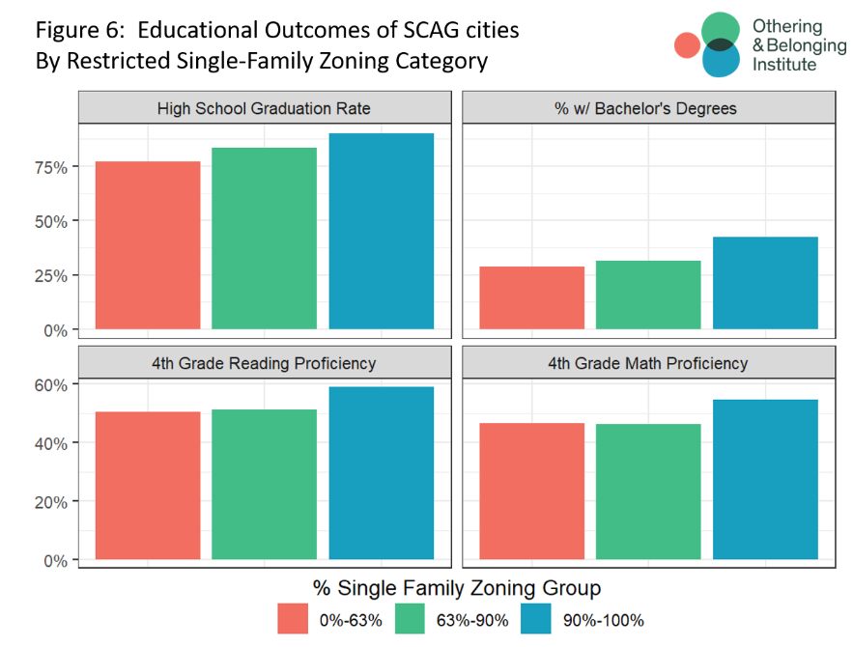
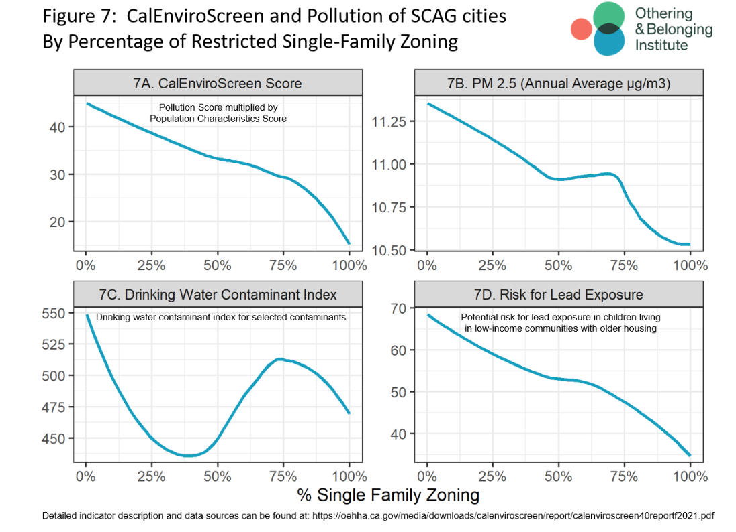
Single family zoning disparities and outcomes

Slide 19



THANK YOU!
Questions?
CatalystCalifornia
CatalystCali
www.catalystcalifornia.org
CatalystCalifornia

Slide 20
Appendix

Slide 21
Protective measures/recommendations from literature
A universal basic income and more safety net supports to prevent houselessness
Subsidizing health coverage and the cost of child care
Increased wages and improved pathways to jobs
Increasing funding for housing assistance and increasing eligibility for it
Increasing income support programs like Earned Income Tax Credit or child tax credit
More affordable housing units and funding for continued development
Eviction moratoriums and other tenant protections

Slide 22
Examples of how community has elevated housing as a priority
Region 1 includes stable, affordable, quality housing in its Bill of Human Rights.
Region 4 included income spent on rent among the indicators of the Region 4 State of the Child reports and included a call out of the work LiBRE and Long Beach Forward do to protect renters from eviction.
Housing was a component of the Region 5 State of the Child Report conclusion that
the family-friendly, low-cost-living in the Antelope Valley, that residents love and depend on, is disappearing and a new, more proactive infrastructure for children and families is needed.

